Slide 1
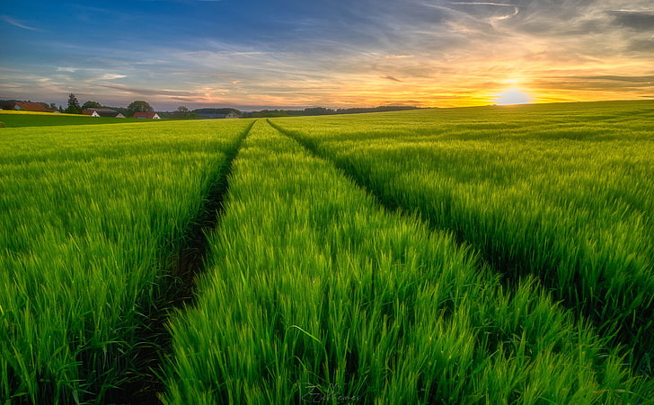






VELAGAPUDI RAMAKRISHNA SIDDHARTHA ENGINEERING COLLEGE
Department of Computer Science and Engineering
IoT-Based Smart Irrigation System with Weather Forecast Integration for Efficient Water Management
20CS5354 - EPICS (REVIEW 1)
Batch No : 16
Guided by:
Ch Raga Madhuri
Asst.Professor

Slide 2



About US
Hemanth Suresh
Sai Kiran
218W1A0542
218W1A0546

Slide 3
ABSTRACT
Efficient water management in agricultural practices is crucial for sustainable farming and resource conservation. This project proposes the development of an IoT-enabled smart irrigation system that leverages weather forecasting data to optimize watering schedules. By integrating real-time weather forecasts, the system aims to enhance water utilization by adjusting irrigation patterns according to upcoming rainfall and temperature conditions. The core of the system involves the utilization of machine learning techniques to analyze historical data and predict the most suitable watering duration for different weather scenarios.The IoT device functions by interfacing with the farmer's irrigation motor. Upon activation, it retrieves and processes weather forecasts for the designated time frame. These forecasts include precipitation probabilities and temperature projections. Using this information, the device employs a trained machine learning model that takes into account historical weather patterns and corresponding watering schedules. The model adjusts the watering duration, ensuring that irrigation is optimized to complement anticipated weather conditions.
Keywords:
Smart Irrigation, IoT, Weather Forecasting, Machine Learning, Water Management, Weather APIs

Slide 4

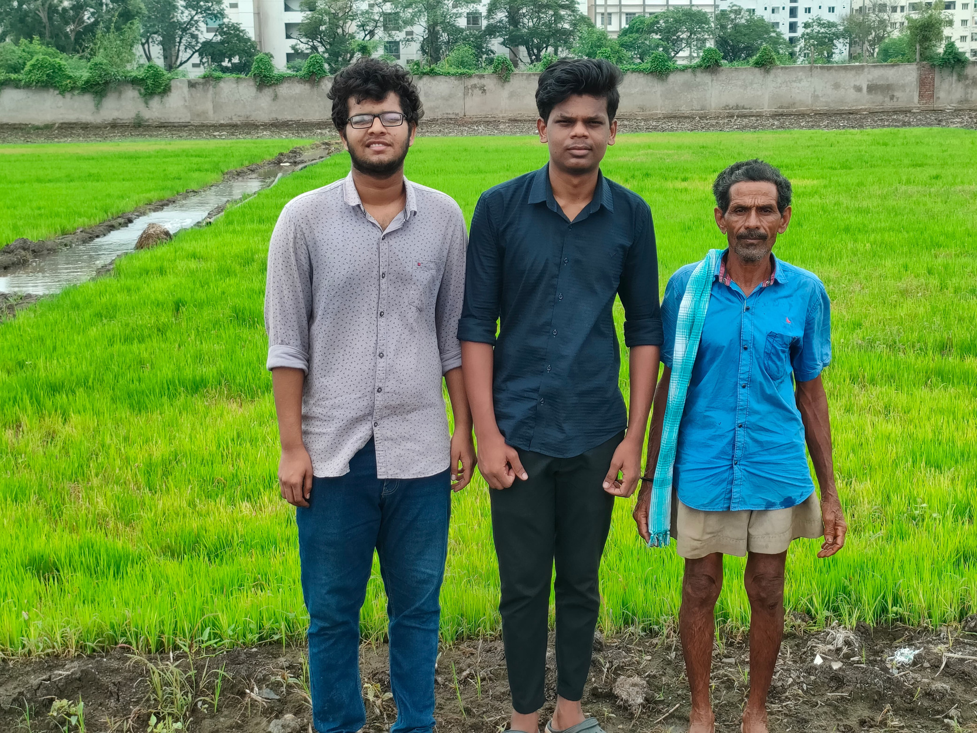
Client Details
Name : M.Appalanaidu
Age : 53
Occupation : Farmer
Village : Kanuru
Land : 2 Acers

Slide 5






Objectives
Optimized Water Usage
Crop Yield Enhancement
Develop an IoT-enabled smart irrigation system that optimizes water usage in agriculture by adjusting irrigation schedules based on real-time weather forecasts and historical data.
Improve crop yields by ensuring that plants receive the appropriate amount of water at the right times, leading to healthier growth and increased agricultural productivity.
Resource Conservation
Cost Reduction
Contribute to the conservation of water resources by reducing water wastage through data-driven and precise irrigation practices, promoting sustainable and responsible water management.
Help farmers reduce irrigation-related costs, including water and energy consumption, leading to increased profitability and economic viability in agriculture.

Slide 6






Scope
Included
Internet Of Things
Machine Learning Algorithms
The project encompasses the development and implementation of the IoT-based smart irrigation system, software components for data collection, analysis, and control.
Machine learning techniques will be utilized for historical data analysis and predictive modeling to optimize watering schedules based on weather conditions.
Real-Time Weather Integration
User Interface
The system will integrate real-time weather forecasting data to make informed irrigation decisions, adjusting watering patterns based on upcoming rainfall, temperature, other relevant weather parameters.
The project includes the creation of a user-friendly interface for farmers to interact with the system.
Not Included
Crop Management
Market and Pricing Data
Crop management practices, such as fertilization, pest control, and crop selection, are not within the scope of this project. The focus is solely on irrigation optimization.
Gathering market-related data, such as crop pricing, market trends, or commodity trading, is not included. The project focuses exclusively on irrigation optimization.

Slide 7
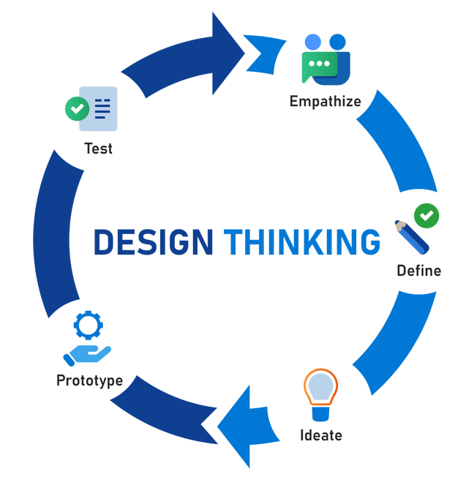
Design Cycle
Empathize:
Conducted interviews and surveys with local farmers and agricultural experts to gain insights into their current irrigation practices and the challenges they face due to unpredictable weather conditions. Collected historical weather data to understand the impact of weather fluctuations on water usage and crop yield.
Define:
Through literature review and stakeholder interviews, several key findings emerged:
Existing irrigation systems often lack real-time weather data integration, leading to suboptimal water usage.
Farmers struggle to make informed decisions about irrigation timing and duration due to inaccurate weather forecasts.
Ideate:
• Brainstormed potential solutions, including the development of an IoT-enabled smart irrigation system.
• Considered leveraging machine learning algorithms for predictive irrigation scheduling.
• Explored various weather data sources to enhance the system's accuracy.
Prototype:
• Developed a prototype of the smart irrigation system, integrating ESP8266-based IoT devices for data collection.
• Implemented a machine learning model (linear regression) to predict optimal irrigation duration based on historical data and real-time weather forecasts.
• Created a user-friendly interface for control of the irrigation system.
Testing:
• Conducted testing with a group of local farmers to gather feedback on system usability and effectiveness.
• Evaluated the accuracy of the machine learning model by comparing predicted irrigation durations with observed crop health and soil moisture levels.
• Ensured that the interface provided clear insights into recommended irrigation adjustments based on weather conditions.

Slide 8
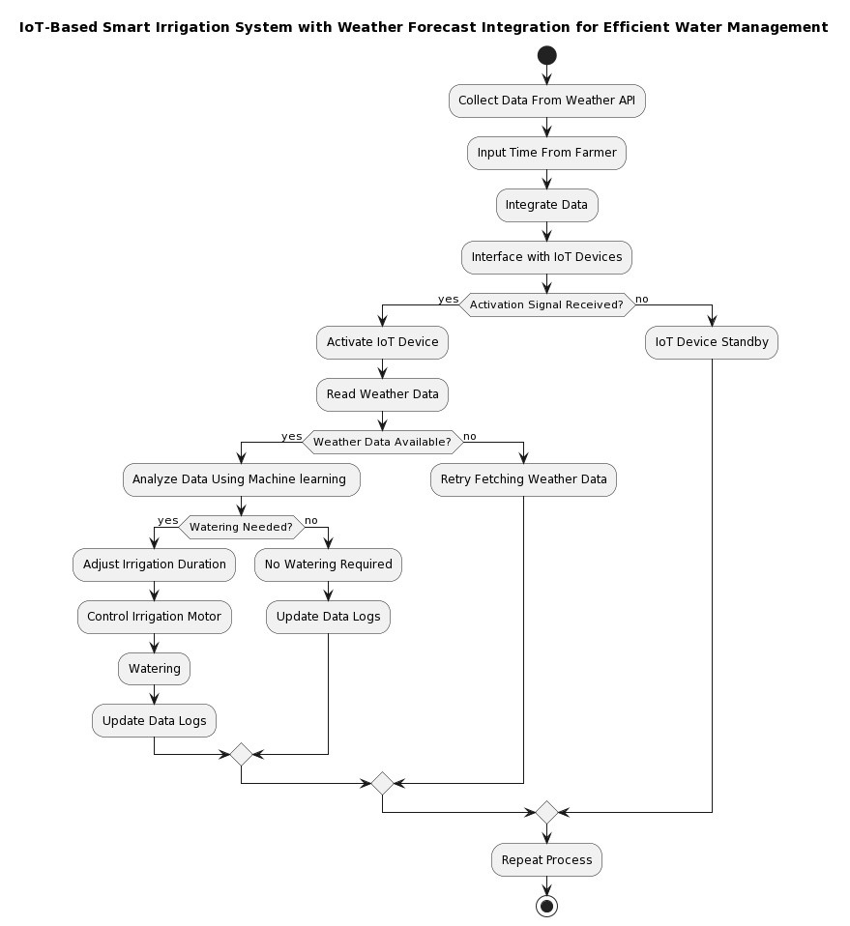
Methodology
Architecture

Slide 9

Methodology
Technology Stack
Hardware
IOT Device - ESP8266
Software
Arduino IDE
Python
Machine Learning (Linear Regression) Libraries
APIs
Appinventor (Mit)
Methods
Weather Forecast Data Retrieval
Machine Learning Model Development
Communication with Iot Devices
Testing and Validation

Slide 10
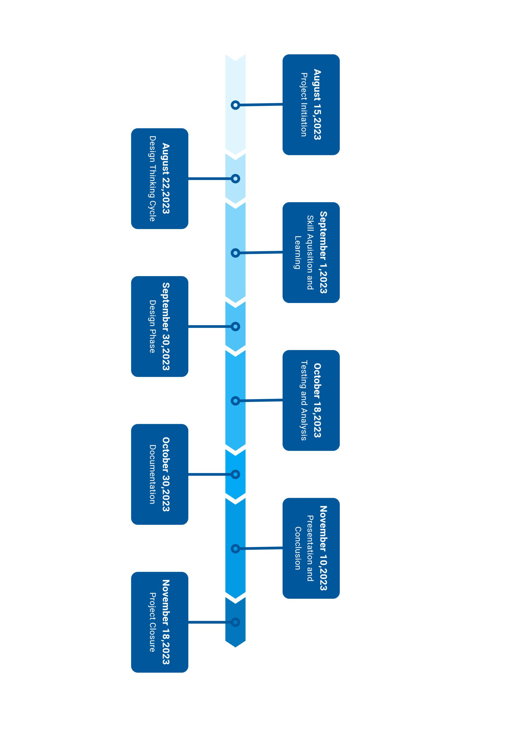
Project Timeline

Slide 11

References
•[1]S, Velmurugan, An IOT Based Smart Irrigation System Using Soil Moisture and Weather Prediction (May 2, 2020). International Journal of Engineering Research & Technology (IJERT), Volume 8, Issue 07, 2020, Available at SSRN: https://ssrn.com/abstract=3597146
•[2]A. Abdullah, S. A. Enazi and I. Damaj, "AgriSys: A smart and ubiquitous controlled-environment agriculture system," 2016 3rd MEC International Conference on Big Data and Smart City (ICBDSC), Muscat, 2016, pp. 1-6
•[3]N. Putjaika, S. Phusae, A. Chen-Im, P. Phunchongharn and K. Akkarajitsakul, "A control system in an intelligent farming by using arduino technology," 2016 Fifth ICT International Student Paper Conference (ICT-ISPC), Nakhon Pathom, 2016, pp. 53-56 . https://ieeexplore.ieee.org/document/7519234
•[4]Goldstein, A., Fink, L., Meitin, A., Bohadana, S., Lutenberg, O., Ravid, G., 2017. Applying machine learning on sensor data for irrigation recommendations: revealing the agronomist’s tacit knowledge. Precis. Agric. 19, 421– 444.
https://doi.org/10.1007/s11119-017-9527-4
•[5]F. Viani, M. Bertolli, M. Salucci, and A. Polo, "Low-cost wireless monitoring and decision support for water saving in agriculture," IEEE Sens. J., vol. 17, pp. 4299-4309, 2017. https://ieeexplore.ieee.org/document/7930391

Slide 12

Thank You

